Slide 1
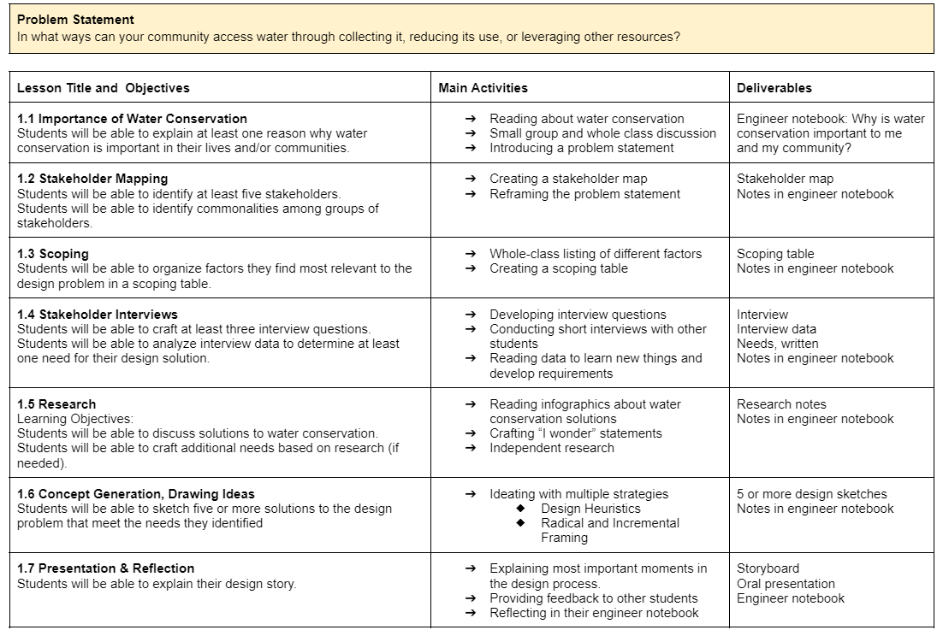
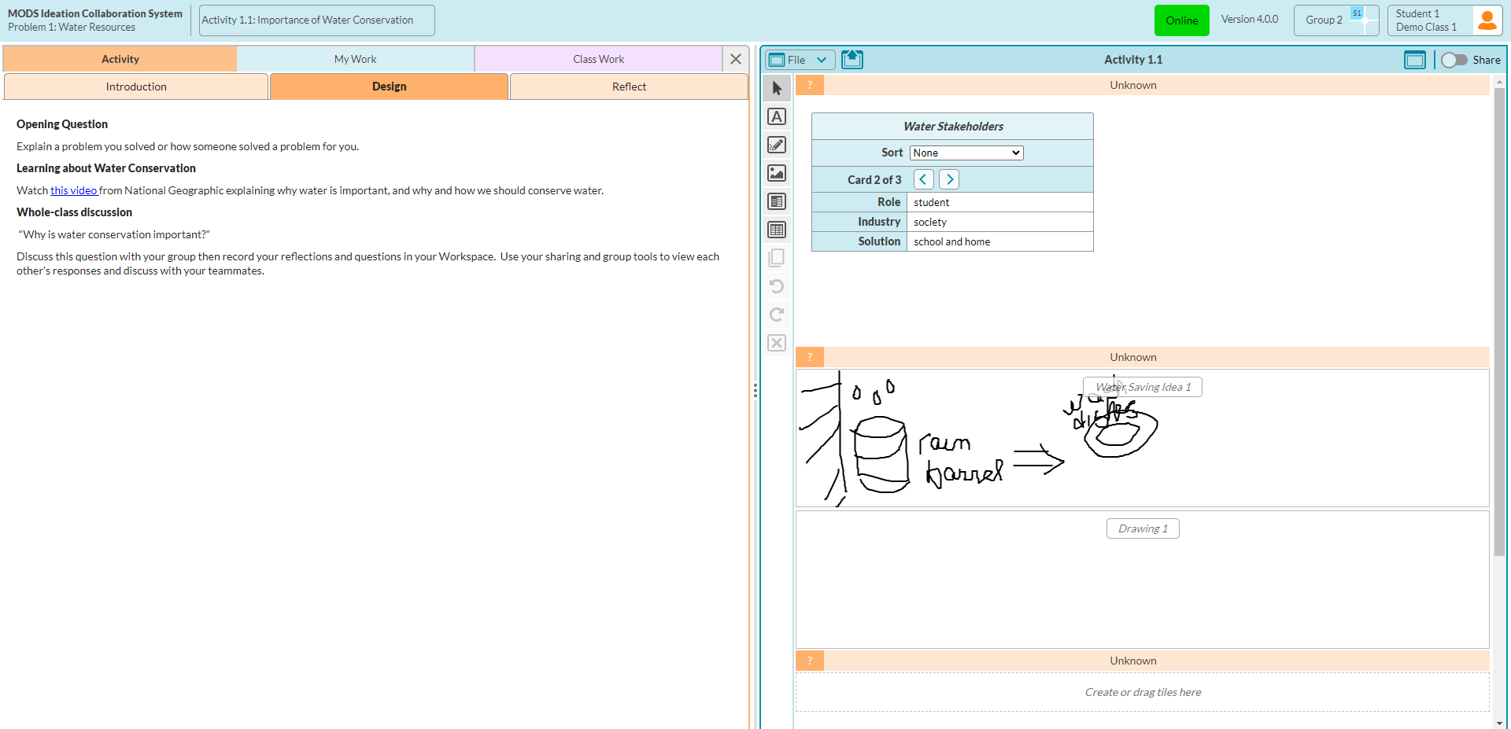
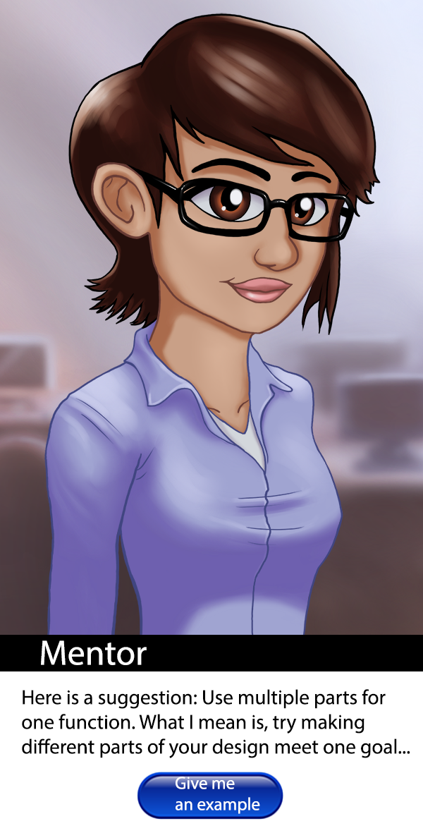
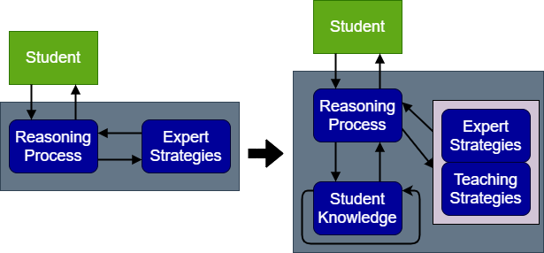
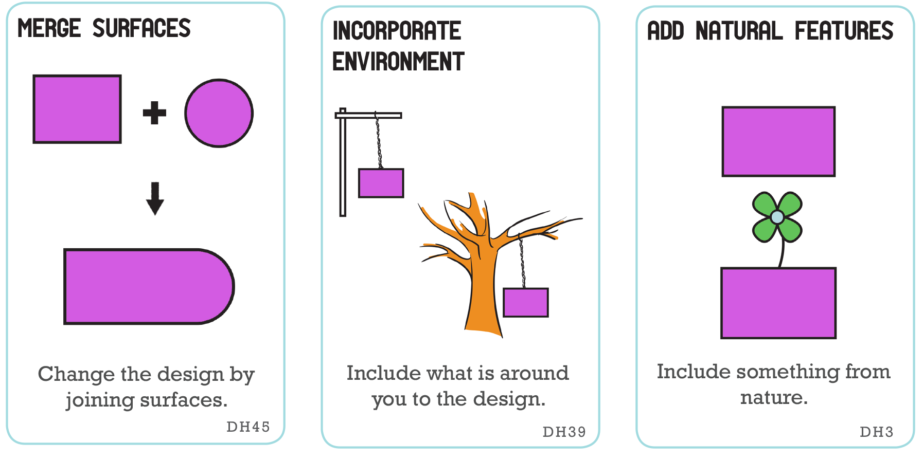
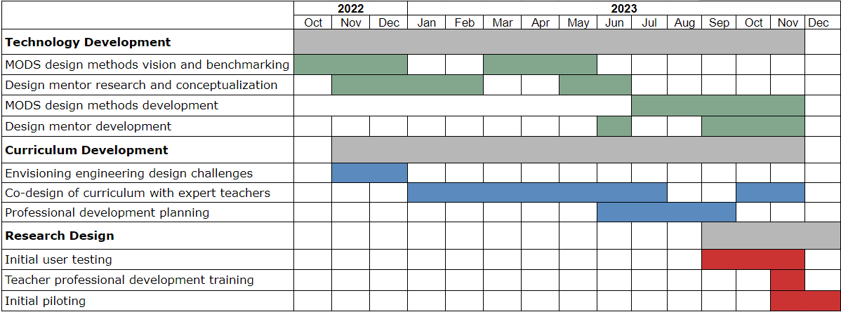




Supporting Secondary Students Earth Science Knowledge and Engineering Design Skills with Mobile Design Studio
Project Objectives
Project Objectives
What We’ve Done So Far
MODS & Design Mentor
Conduct fundamental and design-based research with secondary students
Develop design challenges for complex Earth science problems
Develop Mobile Design Studio as a Collaborative Front-End Design Platform
Develop and integrate an AI-powered design mentor
Research Questions
MODS student interface view
RQ1: How do students engage in design thinking in the project? What informed designer behaviors related to social and contextual awareness and creativity are promoted through the intervention?
RQ2: In what ways and to what extent do students integrate science, engineering, and social considerations, into their understanding of the problem, concept generation and justification?
RQ3: How do students interact with the design mentor while designing, and to what extent do students’ design practices, and STEM integration outcomes differ across versions of the design mentor?
RQ4: In what ways and to what extent do these design activities, impact students’ interests, perceptions of science and engineering and engineering self-efficacy?
Agent Architecture
Curriculum Overview
Design Mentor
Research Team & Acknowledgements
Corey Schimpf, PI - University at Buffalo
Shanna Daly, Co-PI - University of Michigan
Annie Fan, RA - University at Buffalo
Leslie Bondaryk, Tech lead - Concord Consortium
Stephanie Harmon, Curr. Dev. - Concord Consortium
Carolyn Giroux, Curr. Dev. - University of Michigan
Jacquie Handley PD Dev - Purdue University
Design Heuristic Cards Example
Development Plan
This project is funded by the National Science Foundation, grant #2201215. Any opinions, findings, and conclusions or recommendations expressed in these materials are those of the author(s) and do not necessarily reflect the views of the National Science Foundation

